Slide 1
Witness to History
Instructions
Add your name
Replace the central image with a picture representative of yourself
Optionally, replace the other images as well
Insert Name
You can replace any image. Just right-click on it and select “Replace image”
This template has been created by Slidesgo

Slide 2
TIMELINE
Instructions
There is no need to modify this slide
01
02
03
Who I Was Before
What Happened
04
Why I Think It Happened
05
06
My Thoughts at the Time
My Thoughts Now
07
How My Story Relates to the Way I See Myself & Others
08
The Lesson(s) My Story Teaches
Who I Am Now
This template has been created by Slidesgo

Slide 3
01
Who I Was Before
Instructions
Replace the central image with a picture representative of yourself
Optionally, replace the other images as well
This template has been created by Slidesgo

Slide 4
70%
30%
Instructions
Replace “characteristic” with a characteristic relevant to the story
Replace “characteristic” with the opposite characteristic
Characteristic
Opposing Characteristic
This template has been created by Slidesgo

Slide 5
ABOUT ME (Before)
Instructions
Describe who you were before the occurrence of the event or experience that deeply affected you
Replace the central image with a picture representative of yourself
Optionally, replace the other images as well
MY TRAITS
Insert text
Insert text
Insert text
Insert text
Insert text
Insert text
Insert text
This template has been created by Slidesgo

Slide 6
02
What Happened
Instructions
Replace the central image with a picture representative of yourself
Optionally, replace the other images as well
This template has been created by Slidesgo

Slide 7
Insert text
Instructions
Tell the story of the event, which affected you deeply, that you experienced, witnessed, saw on television, or read about that you feel must be known, shared with the world, and/or remembered
The event or experience you select should be one that affected you deeply, so it is irrelevant what other people think in regard to your selection. Choose based on what you think
Optionally, replace the other images as well
This template has been created by Slidesgo

Slide 8
Why I Think It Happened
03
Instructions
Replace the central image with a picture representative of yourself
Optionally, replace the other images as well
This template has been created by Slidesgo

Slide 9
Reasons
Instructions
List some of the reasons you think it happened
Optionally, replace the other images
#3
?
Insert text
#1
#4
Insert text
Insert text
#2
#5
Insert text
Insert text
This template has been created by Slidesgo

Slide 10
My Thoughts at the Time
04
Instructions
Replace the central image with a picture representative of yourself
Optionally, replace the other images as well
This template has been created by Slidesgo

Slide 11
Thoughts (Then)
#1
Instructions
List some of your thoughts just before, during, and/or just after the event occurred
Optionally, replace the other images
Insert text
#2
Insert text
#3
Insert text
This template has been created by Slidesgo

Slide 12
My Thoughts Now
05
Instructions
Replace the central image with a picture representative of yourself
Optionally, replace the other images as well
This template has been created by Slidesgo

Slide 13
Thoughts (Now)
#1
Instructions
Looking back, list some of your thoughts about the event
Optionally, replace the other images
Insert text
#2
Insert text
#3
Insert text
This template has been created by Slidesgo

Slide 14
How My Story Relates to the Way I See Myself & Others
06
Instructions
Replace the central image with a picture representative of yourself
Optionally, replace the other images as well
This template has been created by Slidesgo

Slide 15
How My Story Impacts…
How I See Myself
How I See Others
Instructions
Explain 1. how your story relates to or impacted 1. the way you see yourself, 2. and the way you see others
Optionally, replace the other images
Insert text
Insert text
This template has been created by Slidesgo

Slide 16
The Lesson(s) My Story Teaches
07
Instructions
Replace the central image with a picture representative of yourself
Optionally, replace the other images as well
This template has been created by Slidesgo

Slide 17
Lessons Learned
#1
Instructions
List some of the lessons you learned as a result of the event
Optionally, replace the other images
Insert text
#2
Insert text
#3
Insert text
This template has been created by Slidesgo

Slide 18
08
Who I Am Now
Instructions
Replace the central image with a picture representative of yourself
Optionally, replace the other images as well
This template has been created by Slidesgo

Slide 19
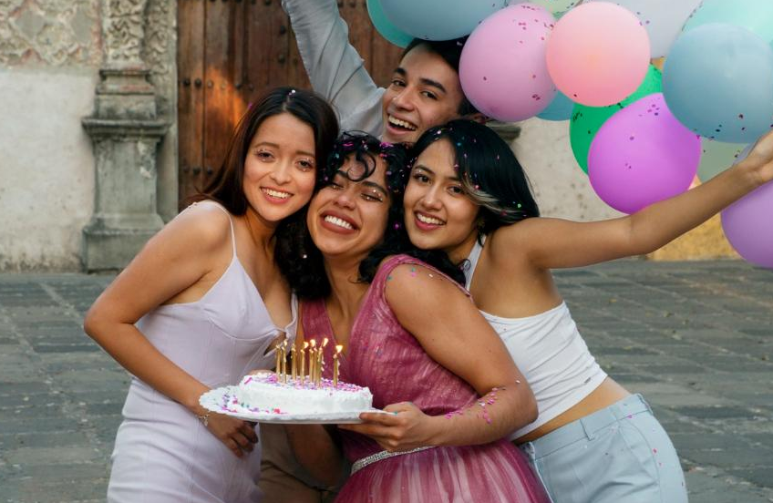
Insert text
Instructions
Describe who you are now (as a result of what happened)
Replace the central image with a picture representative of yourself
Optionally, replace the other images
This template has been created by Slidesgo

Slide 20
—Elie Wiesel
Instructions
There is no need to modify this slide
“I owe them my roots and memory. I am duty-bound to serve as their emissary, transmitting the history of their disappearance, even if it disturbs, even if it brings pain. Not to do so would be to betray them, and thus myself.”
This template has been created by Slidesgo

Slide 21
DID YOU LIKE THIS POST?
Instructions
There is no need to modify this slide, but you are welcome to do so
LOVE IT
SHARE IT
COMMENT
MORE INFO
www.slidesgo.com
]
This template has been created by Slidesgo

Slide 22
THANKS!
Instructions
There is no need to modify this slide, but you are welcome to do so
DO YOU HAVE ANY QUESTIONS?
youremail@freepik.com
+91 620 421 838
yourwebsite.com
Please keep this slide for attribution
This template has been created by Slidesgo

